Slide 1
CS162 Operating Systems and Systems Programming Lecture 21 Filesystems 1: Performance, Queueing Theory, Filesystem Design
April 6th, 2023
Prof. John Kubiatowicz
http://cs162.eecs.Berkeley.edu

Slide 2
Recall: Magnetic Disks
Track
Sector
Cylinders: all the tracks under the head at a given point on all surfaces
Read/write data is a three-stage process:
Seek time: position the head/arm over the proper track
Rotational latency: wait for desired sector to rotate under r/w head
Transfer time: transfer a block of bits (sector) under r/w head
Head
Cylinder
Platter
Disk Latency = Queueing Time + Controller time +
Seek Time + Rotation Time + Xfer Time
Software
Queue
(Device Driver)
Hardware
Controller
Media Time
(Seek+Rot+Xfer)
Request
Result

Slide 3
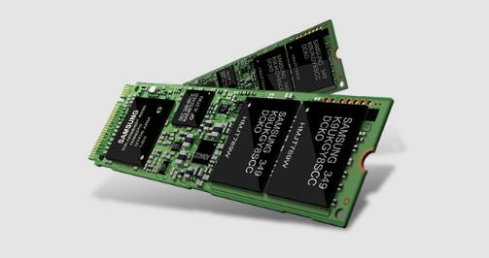
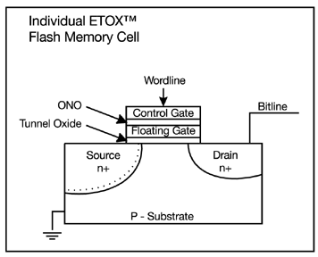
Recall: FLASH Memory
Samsung 2015:
512GB, NAND Flash
Like a normal transistor but:
Has a floating gate that can hold charge
To write: raise or lower wordline high enough to cause charges to tunnel
To read: turn on wordline as if normal transistor
presence of charge changes threshold and thus measured current
Two varieties:
NAND: denser, must be read and written in blocks
NOR: much less dense, fast to read and write
V-NAND: 3D stacking (Samsung claims 1TB possible in 1 chip)

Slide 4
Ways of Measuring Performance: Times (s) and Rates (op/s)
Latency – time to complete a task
Measured in units of time (s, ms, us, …, hours, years)
Response Time - time to initiate and operation and get its response
Able to issue one that depends on the result
Know that it is done (anti-dependence, resource usage)
Throughput or Bandwidth – rate at which tasks are performed
Measured in units of things per unit time (ops/s, GFLOP/s)
Start up or “Overhead” – time to initiate an operation
Most I/O operations are roughly linear in b bytes
Latency(b) = Overhead + b/TransferCapacity
Performance???
Operation time (4 mins to run a mile…)
Rate (mph, mpg, …)

Slide 5
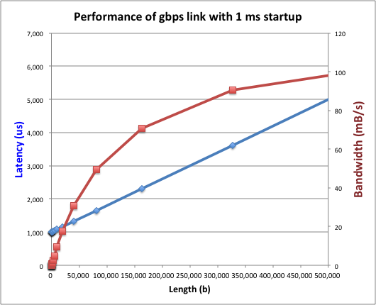
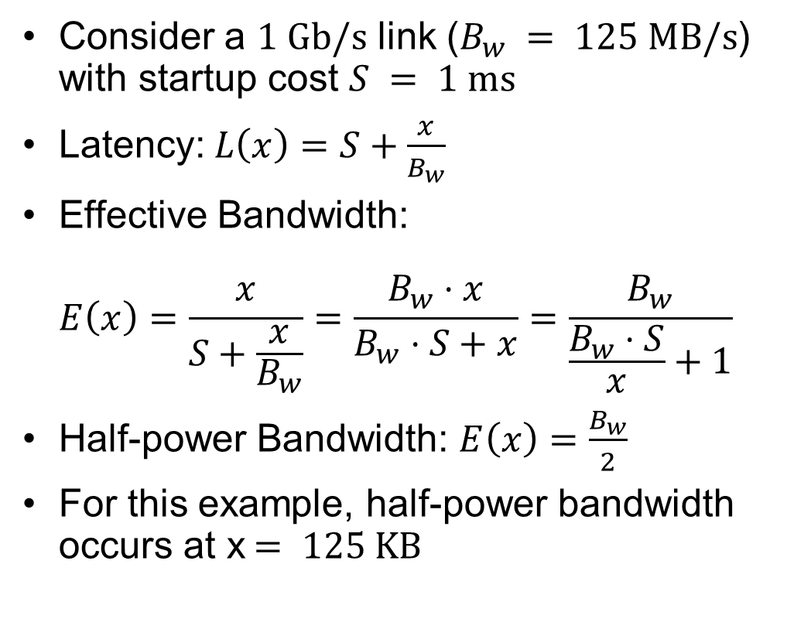
Example: Overhead in Fast Network
Consider a $1 \text{Gb}\text{/}\text{s}$ link ($B_{w} = 125 \text{MB}\text{/}\text{s}$) with startup cost $S = 1 \text{ms}$
Latency:$L\left(x\right)=S+\frac{x}{B_{w}}$
Effective Bandwidth: $E\left(x\right)=\frac{x}{S+\frac{x}{B_{w}}}=\frac{B_{w}⋅x}{B_{w}⋅S+x}=\frac{B_{w}}{\frac{B_{w}⋅S}{x}+1}$
Half-power Bandwidth: $E\left(x\right)=\frac{B_{w}}{2}$
For this example, half-power bandwidth occurs at x$= 125 \text{KB}$
Length (x)

Slide 6
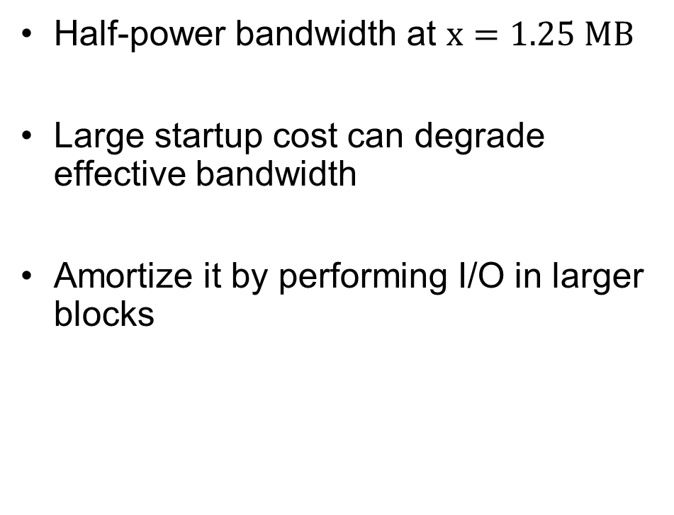
Example: 10 ms Startup Cost (e.g., Disk)
Half-power bandwidth at $x=1.25 \text{MB}$
Large startup cost can degrade effective bandwidth
Amortize it by performing I/O in larger blocks
Half-power x = 1,250,000 bytes!
Length (x)

Slide 7
What Determines Peak BW for I/O?
Bus Speed
PCI-X: 1064 MB/s = 133 MHz x 64 bit (per lane)
ULTRA WIDE SCSI: 40 MB/s
Serial Attached SCSI & Serial ATA & IEEE 1394 (firewire): 1.6 Gb/s full duplex (200 MB/s)
USB 3.0 – 5 Gb/s
Thunderbolt 3 – 40 Gb/s
Device Transfer Bandwidth
Rotational speed of disk
Write / Read rate of NAND flash
Signaling rate of network link
Whatever is the bottleneck in the path…

Slide 8
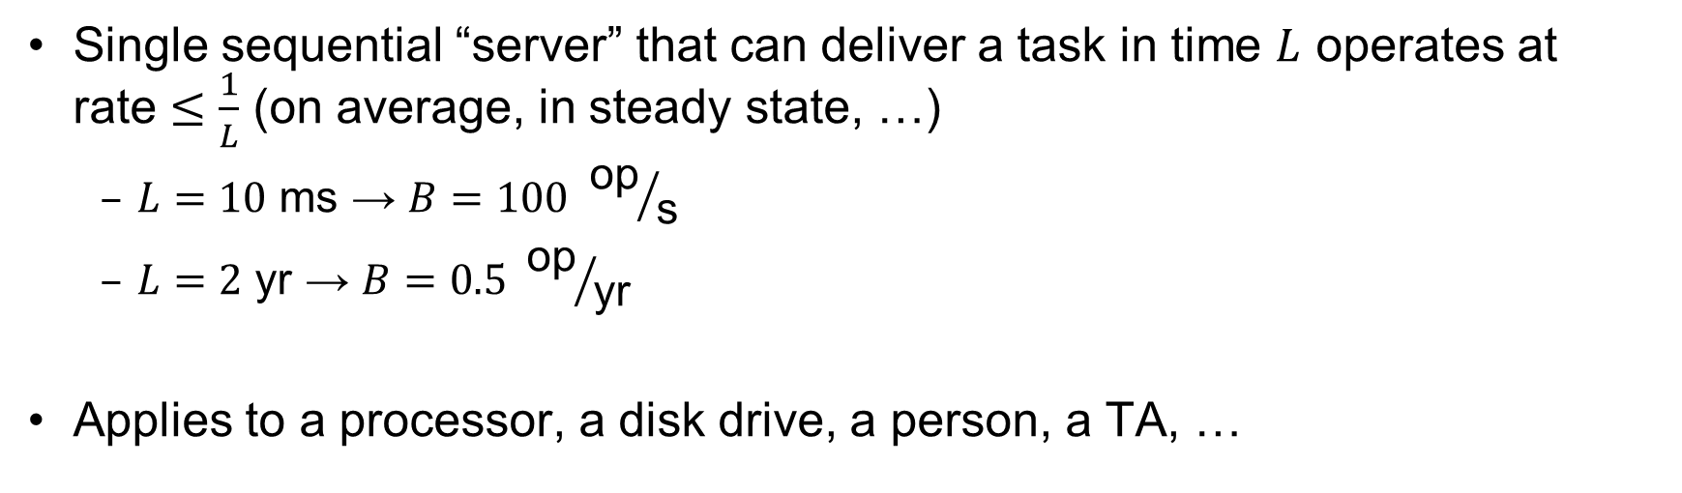
Sequential Server Performance
L
L
L
L
…
L
time
Single sequential “server” that can deliver a task in time $L$ operates at rate $≤\frac{1}{L}$ (on average, in steady state, …)
$L=10 \text{ms}$ → $B=100 {\text{op}}/{\text{s}}$
$L=2 \text{yr}$ → $B=0.5 {\text{op}}/{\text{yr}}$
Applies to a processor, a disk drive, a person, a TA, …

Slide 9
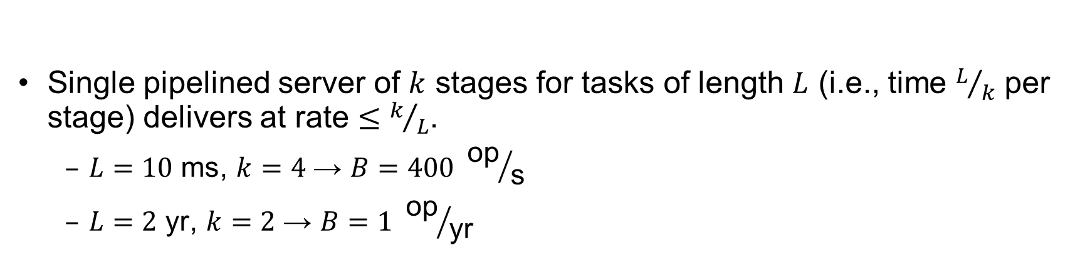
Single Pipelined Server
L
L
divided over distinct resources
logical operation
L
L
L
L
L
L
L
…
time
Single pipelined server of $k$ stages for tasks of length $L$ (i.e., time $L/k$ per stage) delivers at rate $≤k/L$.
$L=10 \text{ms}$, $k=4$ → $B=400 {\text{op}}/{\text{s}}$
$L=2 \text{yr}$, $k=2$ → $B=1 {\text{op}}/{\text{yr}}$

Slide 10
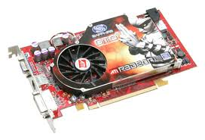

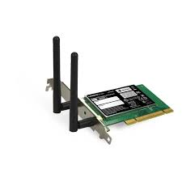
Example Systems “Pipelines”
I/O Processing
File
System
Upper Driver
Lower Driver
User Process
syscall
Communication
Anything with queues between operational process behaves roughly “pipeline like”
Important difference is that “initiations” are decoupled from processing
May have to queue up a burst of operations
Not synchronous and deterministic like in 61C

Slide 11
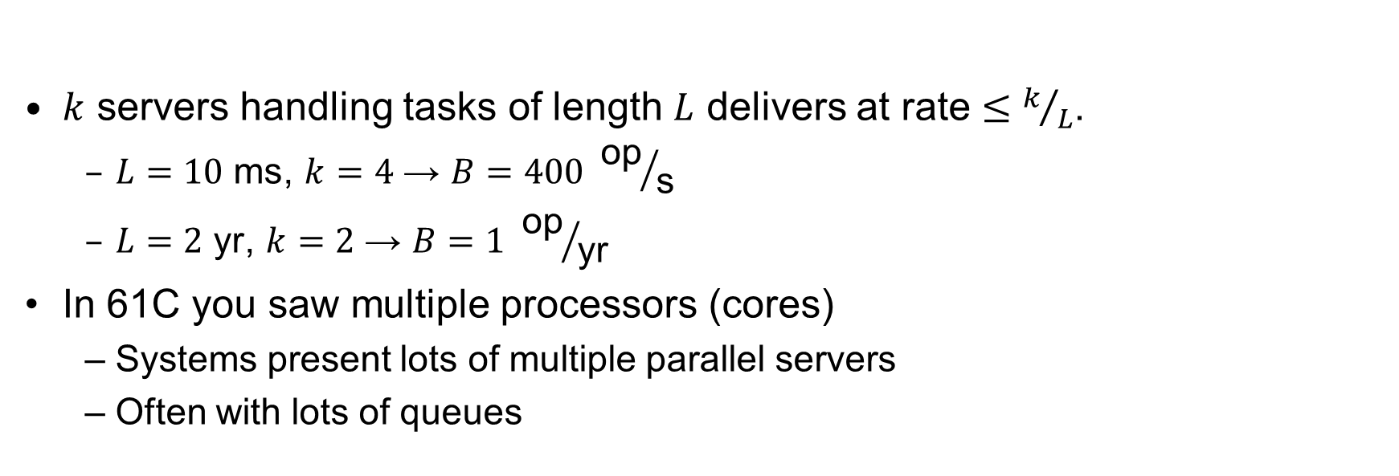
Multiple Servers
L
…
k
$k$ servers handling tasks of length $L$ delivers at rate $≤k/L$.
$L=10 \text{ms}$, $k=4$ → $B=400 {\text{op}}/{\text{s}}$
$L=2 \text{yr}$, $k=2$ → $B=1 {\text{op}}/{\text{yr}}$
In 61C you saw multiple processors (cores)
Systems present lots of multiple parallel servers
Often with lots of queues

Slide 12

Example Systems “Parallelism”
I/O Processing
syscall
File
System
Upper Driver
Lower Driver
User Process
User Process
User Process
Communication
Parallel Computation, Databases, …

Slide 13
I/O Performance
300
Response
Time (ms)
Controller
User
Thread
I/O
device
200
Queue
[OS Paths]
100
Response Time = Queue + I/O device service time
0
Performance of I/O subsystem
Metrics: Response Time, Throughput
Effective BW per op = transfer size / response time
EffBW(n) = n / (S + n/B) = B / (1 + SB/n )
0%
100%
Throughput (Utilization)
(% total BW)
# of ops
time per op
Fixed overhead

Slide 14
I/O Performance
300
Response
Time (ms)
Controller
User
Thread
I/O
device
200
Queue
[OS Paths]
100
Response Time = Queue + I/O device service time
0
Performance of I/O subsystem
Metrics: Response Time, Throughput
Effective BW per op = transfer size / response time
EffBW(n) = n / (S + n/B) = B / (1 + SB/n )
Contributing factors to latency:
Software paths (can be loosely modeled by a queue)
Hardware controller
I/O device service time
Queuing behavior:
Can lead to big increases of latency as utilization increases
Solutions?
0%
100%
Throughput (Utilization)
(% total BW)

Slide 15
A Simple Deterministic World
arrivals
Queue
Server
departures
T_{Q}
T_{S}
T_{A}
T_{A}
T_{A}
T_{q}
T_{S}
Assume requests arrive at regular intervals, take a fixed time to process, with plenty of time between …
Service rate (μ = 1/T_{S}) - operations per second
Arrival rate: (λ = 1/T_{A}) - requests per second
Utilization: U = λ/μ , where λ < μ
Average rate is the complete story

Slide 16
A Ideal Linear World
Saturation
1
1
Delivered Throughput
Delivered Throughput
Empty Queue
Unbounded
0
1
0
1
Offered Load (T_{S}/T_{A})
Offered Load (T_{S}/T_{A})
Queue delay
Queue delay
time
time
What does the queue wait time look like?
Grows unbounded at a rate ~ (T_{s}/T_{A}) till request rate subsides

Slide 17
A Bursty World
arrivals
Queue
Server
departures
T_{Q}
T_{S}
Arrivals
Q depth
Server
Requests arrive in a burst, must queue up till served
Same average arrival time, but almost all of the requests experience large queue delays
Even though average utilization is low

Slide 18
So how do we model the burstiness of arrival?
Elegant mathematical framework if you start with exponential distribution
Probability density function of a continuous random variable with a mean of 1/λ
f(x) = λe^{-λx}
“Memoryless”
Likelihood of an event occurring is independent of how long we’ve been waiting
mean arrival interval (1/λ)
Lots of short arrival intervals (i.e., high instantaneous rate)
Few long gaps (i.e., low instantaneous rate)
x (λ)

Slide 19
Background: General Use of Random Distributions
Mean
(m)
Server spends variable time (T) with customers
Mean (Average) m = Σp(T)×T
Variance (stddev²) σ² = Σp(T)×(T-m)² = Σp(T)×T²-m²
Squared coefficient of variance: C = σ²/m² Aggregate description of the distribution
Important values of C:
No variance or deterministic ⇒ C=0
“Memoryless” or exponential ⇒ C=1
Past tells nothing about future
Poisson process – purely or completely random process
Many complex systems (or aggregates) are well described as memoryless
Disk response times C ≈ 1.5 (majority seeks < average)
σ
Distribution
of service times
mean
Memoryless

Slide 20
Introduction to Queuing Theory
Controller
Arrivals
Disk
Departures
Queue
Queuing System
What about queuing time??
Let’s apply some queuing theory
Queuing Theory applies to long term, steady state behavior ⇒ Arrival rate = Departure rate
Arrivals characterized by some probabilistic distribution
Departures characterized by some probabilistic distribution
Notes:
Old and New Testament by Kleirock
Regret skipping as grad student

Slide 21
Little’s Law
N
arrivals
departures
λ
L
In any stable system
Average arrival rate = Average departure rate
The average number of jobs/tasks in the system (N) is equal to arrival time / throughput (λ) times the response time (L)
N (jobs) = λ (jobs/s) x L (s)
Regardless of structure, bursts of requests, variation in service
Instantaneous variations, but it washes out in the average
Overall, requests match departures

Slide 22
Example
L = 5
λ = 1
L = 5
N = 5 jobs
Jobs
0
1
2
3
4
5
6
7
8
9
10
11
12
13
14
15
16
time
A: N = λ x L
E.g., N = λ x L = 5

Slide 23
Little’s Theorem: Proof Sketch
N
arrivals
departures
λ
Job i
L(i) = response time of job i
N(t) = number of jobs in system
at time t
L
N(t)
time
L(1)
T

Slide 24
Little’s Theorem: Proof Sketch
N
arrivals
departures
λ
Job i
L(i) = response time of job i
N(t) = number of jobs in system
at time t
L
N(t)
time
T
What is the system occupancy, i.e., average
number of jobs in the system?

Slide 25
Little’s Theorem: Proof Sketch
N
arrivals
departures
λ
Job i
L(i) = response time of job i
N(t) = number of jobs in system
at time t
S(i) = L(i) * 1 = L(i)
L
S(k)
N(t)
S(2)
S(1)
time
T
S = S(1) + S(2) + … + S(k) = L(1) + L(2) + … + L(k)

Slide 26
Little’s Theorem: Proof Sketch
N
arrivals
departures
λ
Job i
L(i) = response time of job i
N(t) = number of jobs in system
at time t
S(i) = L(i) * 1 = L(i)
L
N(t)
S= area
time
T
Average occupancy (N_{avg}) = S/T

Slide 27
Little’s Theorem: Proof Sketch
N
arrivals
departures
λ
Job i
L(i) = response time of job i
N(t) = number of jobs in system
at time t
S(i) = L(i) * 1 = L(i)
L
S(k)
N(t)
S(2)
S(1)
time
T
N_{avg} = S/T = (L(1) + … + L(k))/T

Slide 28
Little’s Theorem: Proof Sketch
N
arrivals
departures
λ
Job i
L(i) = response time of job i
N(t) = number of jobs in system
at time t
S(i) = L(i) * 1 = L(i)
L
S(k)
N(t)
S(2)
S(1)
time
T
N_{avg} = (L(1) + … + L(k))/T = (N_{total}/T)*(L(1) + … + L(k))/N_{total}

Slide 29
Little’s Theorem: Proof Sketch
N
arrivals
departures
λ
Job i
L(i) = response time of job i
N(t) = number of jobs in system
at time t
S(i) = L(i) * 1 = L(i)
L
S(k)
N(t)
S(2)
S(1)
time
T
N_{avg} = (N_{total}/T)*(L(1) + … + L(k))/N_{total} = λ_{avg} × L_{avg}

Slide 30
Little’s Theorem: Proof Sketch
N
arrivals
departures
λ
Job i
L(i) = response time of job i
N(t) = number of jobs in system
at time t
S(i) = L(i) * 1 = L(i)
L
S(k)
N(t)
S(2)
S(1)
time
T
N_{avg} = λ_{avg} × L_{avg}

Slide 31

Little’s Law Applied to a Queue
When Little’s Law applied to a queue, we get:
Average Arrival Rate
$$L_{Q}=λT_{Q}$$
Average length of the queue
Average time “waiting” in queue

Slide 32
A Little Queuing Theory: Computing T_{Q}
Assumptions:
System in equilibrium; No limit to the queue
Time between successive arrivals is random and memoryless
Parameters that describe our system:
λ: mean number of arriving customers/second
T_{ser}: mean time to service a customer (“m1”)
C: squared coefficient of variance = σ²/m1²
μ: service rate = 1/T_{ser}
u: server utilization (0≤u≤1): u = λ/μ = λ × T_{ser}
Results:
Memoryless service distribution (C = 1): (an “M/M/1 queue”):
T_{q} = T_{ser} x u/(1 – u)
General service distribution, 1 server (an “M/G/1 queue”):
T_{q} = T_{ser} x ½(1+C) x u/(1 – u)
Why does response/queueing delay grow unboundedly even though the utilization is < 1 ?
Queue
Server
300
Response
Time (ms)
Arrival Rate
λ
Service Rate
μ=1/T_{ser}
200
100
0
0%
100%
Throughput (Utilization)
(% total BW)

Slide 33
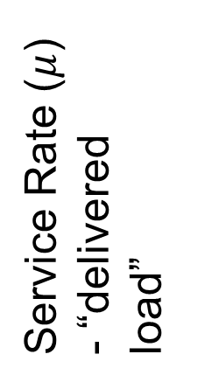
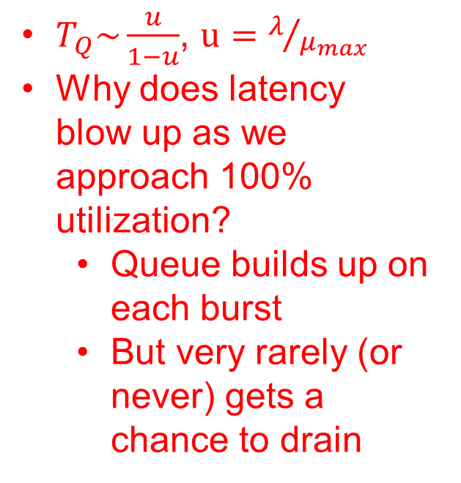
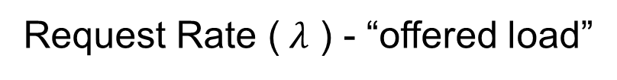
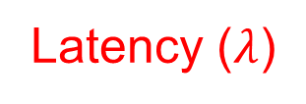


System Performance In presence of a Queue
$T_{Q}\sim \frac{u}{1−u}$, $u=λ/{μ_{max}}$
Why does latency blow up as we approach 100% utilization?
Queue builds up on each burst
But very rarely (or never) gets a chance to drain
Latency ($λ$)
Service Rate ($μ$) - “delivered load”
Time
$$μmax$$
Operation Time
$$μmax$$
Request Rate ($λ$ ) - “offered load”
“Half-Power Point” : load at which system delivers half of peak performance
Design and provision systems to operate roughly in this regime
Latency low and predictable, utilization good: ~50%

Slide 34
Why unbounded response time?
Assume deterministic arrival process and service time
Possible to sustain utilization = 1 with bounded response time!
time
arrival time
service time

Slide 35
Why unbounded response time?
300
Response
Time (ms)
Assume stochastic arrival process (and service time)
No longer possible to achieve utilization = 1
200
100
This wasted time can never be reclaimed! So cannot achieve u = 1!
0
0%
100%
Throughput (Utilization)
(% total BW)
time

Slide 36
A Little Queuing Theory: An Example
Example Usage Statistics:
User requests 10 x 8KB disk I/Os per second
Requests & service exponentially distributed (C=1.0)
Avg. service = 20 ms (From controller+seek+rot+trans)
Questions:
How utilized is the disk?
Ans: server utilization, u = λT_{ser}
What is the average time spent in the queue?
Ans: T_{q}
What is the number of requests in the queue?
Ans: L_{q}
What is the avg response time for disk request?
Ans: T_{sys} = T_{q} + T_{ser}
Computation:
λ (avg # arriving customers/s) = 10/s
T_{ser} (avg time to service customer) = 20 ms (0.02s)
u (server utilization) = λ x T_{ser}= 10/s x .02s = 0.2
T_{q} (avg time/customer in queue) = T_{ser} x u/(1 – u) = 20 x 0.2/(1-0.2) = 20 x 0.25 = 5 ms (0 .005s)
L_{q} (avg length of queue) = λ x T_{q}=10/s x .005s = 0.05
T_{sys} (avg time/customer in system) =T_{q} + T_{ser}= 25 ms

Slide 37
Queuing Theory Resources
Resources page contains Queueing Theory Resources (under Readings):
Scanned pages from Patterson and Hennessy book that gives further discussion and simple proof for general equation: https://cs162.eecs.berkeley.edu/static/readings/patterson_queue.pdf
A complete website full of resources: http://web2.uwindsor.ca/math/hlynka/qonline.html
Some previous midterms with queueing theory questions
Assume that Queueing Theory is fair game for Midterm III!

Slide 38
Optimize I/O Performance
Controller
300
Response
Time (ms)
User
Thread
I/O
device
200
Queue
[OS Paths]
100
Response Time = Queue + I/O device service time
0
0%
100%
How to improve performance?
Make everything faster ☺
More Decoupled (Parallelism) systems
multiple independent buses or controllers
Optimize the bottleneck to increase service rate
Use the queue to optimize the service
Do other useful work while waiting
Queues absorb bursts and smooth the flow
Admissions control (finite queues)
Limits delays, but may introduce unfairness and livelock
Throughput (Utilization)
(% total BW)

Slide 39

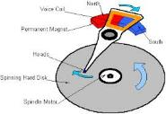




Recall: I/O and Storage Layers
Application / Service
High Level I/O
Streams
Low Level I/O
File Descriptors
What we covered in Lecture 4
Syscall
open(), read(), write(), close(), …
Open File Descriptions
File System
Files/Directories/Indexes
What we will cover next…
I/O Driver
Commands and Data Transfers
Disks, Flash, Controllers, DMA
What we just covered…

Slide 40
From Storage to File Systems
I/O API and
syscalls
Variable-Size Buffer
Memory Address
Logical Index, Typically 4 KB
File System
Block
Flash Trans. Layer
Hardware Devices
Sector(s)
Sector(s)
Sector(s)
Phys. Block
Phys Index., 4KB
Physical Index,
512B or 4KB
Erasure Page
HDD
SSD

Slide 41
Building a File System
File System: Layer of OS that transforms block interface of disks (or other block devices) into Files, Directories, etc.
Classic OS situation: Take limited hardware interface (array of blocks) and provide a more convenient/useful interface with:
Naming: Find file by name, not block numbers
Organize file names with directories
Organization: Map files to blocks
Protection: Enforce access restrictions
Reliability: Keep files intact despite crashes, hardware failures, etc.

Slide 42
Recall: User vs. System View of a File
User’s view:
Durable Data Structures
System’s view (system call interface):
Collection of Bytes (UNIX)
Doesn’t matter to system what kind of data structures you want to store on disk!
System’s view (inside OS):
Collection of blocks (a block is a logical transfer unit, while a sector is the physical transfer unit)
Block size ≥ sector size; in UNIX, block size is 4KB

Slide 43

Translation from User to System View
File (Bytes)
File
System
What happens if user says: “give me bytes 2 – 12?”
Fetch block corresponding to those bytes
Return just the correct portion of the block
What about writing bytes 2 – 12?
Fetch block, modify relevant portion, write out block
Everything inside file system is in terms of whole-size blocks
Actual disk I/O happens in blocks
read/write smaller than block size needs to translate and buffer

Slide 44
Disk Management
Basic entities on a disk:
File: user-visible group of blocks arranged sequentially in logical space
Directory: user-visible index mapping names to files
The disk is accessed as linear array of sectors
How to identify a sector?
Physical position
Sectors is a vector [cylinder, surface, sector]
Not used anymore
OS/BIOS must deal with bad sectors
Logical Block Addressing (LBA)
Every sector has integer address
Controller translates from address ⇒ physical position
Shields OS from structure of disk

Slide 45
What Does the File System Need?
Track free disk blocks
Need to know where to put newly written data
Track which blocks contain data for which files
Need to know where to read a file from
Track files in a directory
Find list of file's blocks given its name
Where do we maintain all of this?
Somewhere on disk

Slide 46
Data Structures on Disk
Somewhat different from data structures in memory
Access a block at a time
Can't efficiently read/write a single word
Have to read/write full block containing it
Ideally want sequential access patterns
Durability
Ideally, file system is in meaningful state upon shutdown
This obviously isn't always the case…

Slide 47
File System Design

Slide 48
Critical Factors in File System Design
(Hard) Disks Performance !!!
Maximize sequential access, minimize seeks
Open before Read/Write
Can perform protection checks and look up where the actual file resource are, in advance
Size is determined as they are used !!!
Can write (or read zeros) to expand the file
Start small and grow, need to make room
Organized into directories
What data structure (on disk) for that?
Need to carefully allocate / free blocks
Such that access remains efficient

Slide 49
Components of a File System
File path
Directory
Structure
File
Header
Structure
One Block = multiple sectors
Ex: 512 sector, 4K block
File number
“inumber”
Data blocks
“inode”
…

Slide 50
Example of BSD/Linux-like Inode structure
Sample file in multilevel indexed format:
Data Stored in Blocks
10 direct ptrs, 1K blocks
One Indirect block
One Doubly-indirect Block
One Triply-indirect Block
Example accesses
How many accesses for block #23? (assume file header accessed on open)?
Two: One for indirect block, one for data
How about block #5?
One: One for data
Block #340?
Three: double indirect block, indirect block, and data

Slide 51
Recall: Abstract Representation of a Process
Process
Suppose that we execute
open(“foo.txt”)
and that the result is 3
Next, suppose that we execute
read(3, buf, 100)
and that the result is 100
Thread’s Regs
Address Space (Memory)
…
User Space
Kernel Space
File Descriptors
Open File Description
3
Not shown: Initially contains 0, 1, and 2 (stdin, stdout, stderr)
File: foo.txt
Position: 100

Slide 52
Components of a File System
Process
Open file description is better described as remembering the inumber (file number) of the file, not its name
Thread’s Regs
Address Space (Memory)
…
User Space
Kernel Space
File Descriptors
Open File Description
3
File: foo.txt inumber
Position: 100
Not shown: Initially contains 0, 1, and 2 (stdin, stdout, stderr)

Slide 53
Components of a File System
file name
offset
file number
offset
storage block
directory structure
index structure (“inode”)
Open performs Name Resolution
Translates path name into a “file number”
Read and Write operate on the file number
Use file number as an “index” to locate the blocks
4 components:
directory, index structure, storage blocks, free space map

Slide 54
How to get the File Number?
Look up in directory structure
A directory is a file containing <file_name : file_number> mappings
File number could be a file or another directory
Operating system stores the mapping in the directory in a format it interprets
Each <file_name : file_number> mapping is called a directory entry
Process isn’t allowed to read the raw bytes of a directory
The read function doesn’t work on a directory
Instead, see readdir, which iterates over the map without revealing the raw bytes
Why shouldn’t the OS let processes read/write the bytes of a directory?

Slide 55
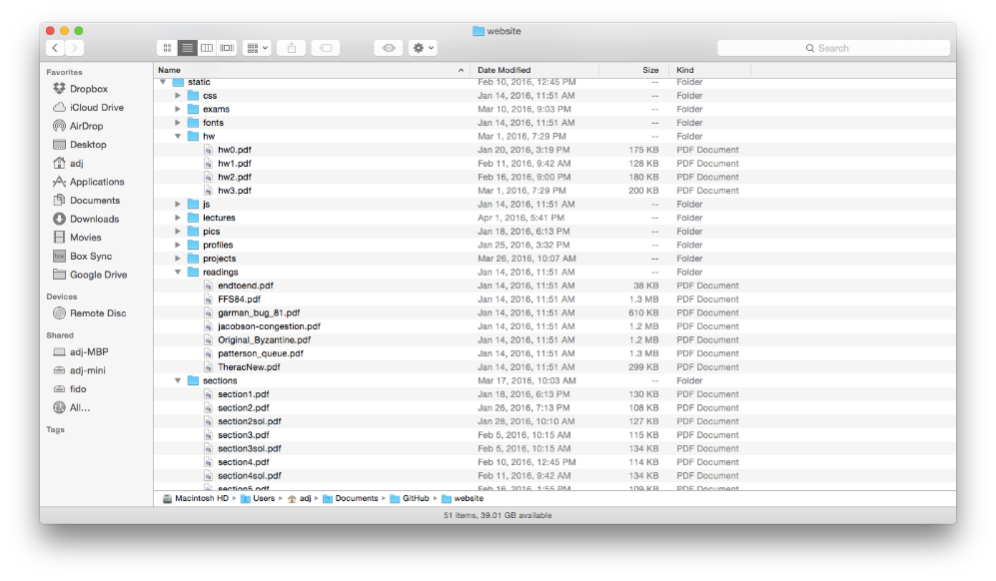
Directories

Slide 56
Directory Abstraction
Directories are specialized files
Contents: List of pairs <file name, file number>
System calls to access directories
open / creat / readdir traverse the structure
mkdir / rmdir add/remove entries
link / unlink (rm)
libc support
DIR * opendir (const char *dirname)
struct dirent * readdir (DIR *dirstream)
int readdir_r (DIR *dirstream, struct dirent *entry, struct dirent **result)
/usr
/usr/lib
/usr/lib4.3
/usr/lib4.3/foo

Slide 57
Directory Structure
How many disk accesses to resolve “/my/book/count”?
Read in file header for root (fixed spot on disk)
Read in first data block for root
Table of file name/index pairs.
Search linearly – ok since directories typically very small
Read in file header for “my”
Read in first data block for “my”; search for “book”
Read in file header for “book”
Read in first data block for “book”; search for “count”
Read in file header for “count”
Current working directory: Per-address-space pointer to a directory used for resolving file names
Allows user to specify relative filename instead of absolute path (say CWD=“/my/book” can resolve “count”)

Slide 58
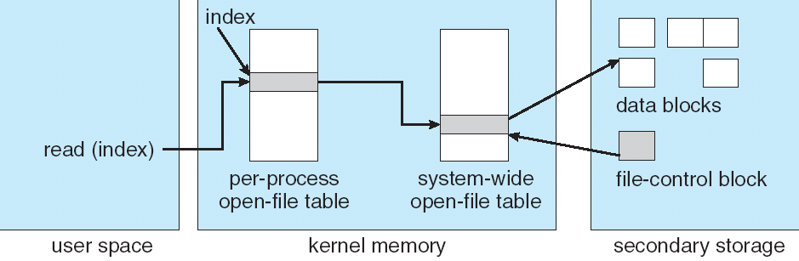
In-Memory File System Structures
fd
(fd)
inode
Open syscall: find inode on disk from pathname (traversing directories)
Create “in-memory inode” in system-wide open file table
One entry in this table no matter how many instances of the file are open
Read/write syscalls look up in-memory inode using the file handle

Slide 59
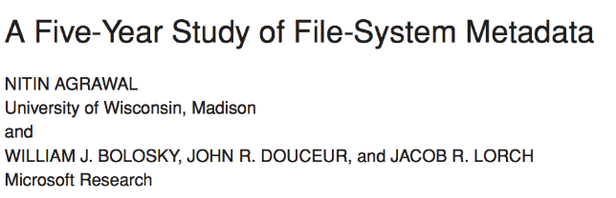
Characteristics of Files
Published in FAST 2007

Slide 60
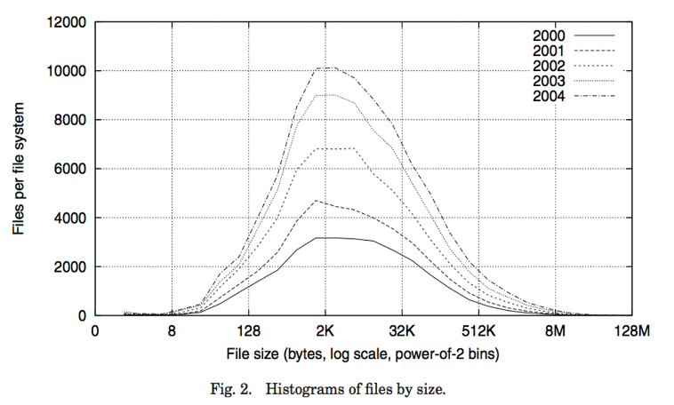
Observation #1: Most Files Are Small

Slide 61
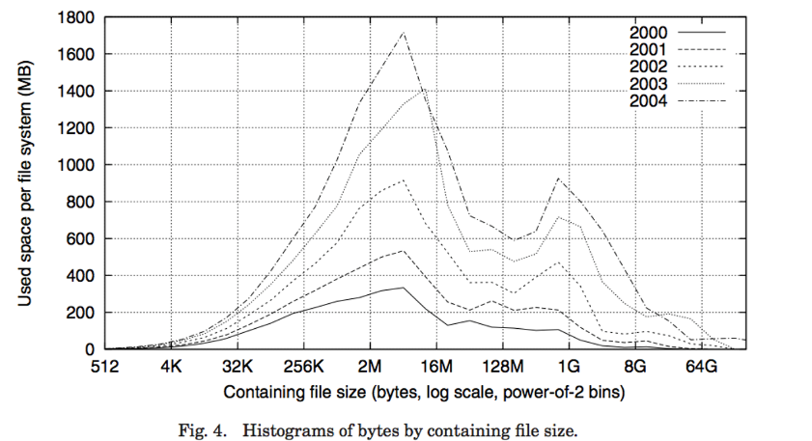
Observation #2: Most Bytes are in Large Files

Slide 62
Conclusion
Bursts & High Utilization introduce queuing delays
Queuing Latency:
M/M/1 and M/G/1 queues: simplest to analyze
As utilization approaches 100%, latency → ∞
T_{q} = T_{ser} x ½(1+C) x u/(1 – u))
File System:
Transforms blocks into Files and Directories
Optimize for access and usage patterns
Maximize sequential access, allow efficient random access
File (and directory) defined by header, called “inode”
Naming: translating from user-visible names to actual sys resources
Directories used for naming for local file systems
Linked or tree structure stored in files

